Slide 1


TECHNO-ECONOMIC FEASIBILITY REPORT
FOR VINYL ESTER RESIN MANUFACTURING
Prepared for:
www.techciresearch.com
MARKET INTELLIGENCE . CONSULTING
© TechSci Research

Slide 2

Final Findings
Product Name | Demand Supply Gap -2025 | Demand Supply Gap -2030 | Export Potential | Backward Integration | Forward Integration | Recommendations
Unsaturated Polyester Resin | Medium | High | Yes | Yes | No | Project can be planned by 2023
Vinyl Ester Resin (BPA) | Medium | High | Yes | No | Yes | Project can be planned by 2023
Vinyl Ester Resin (BPF) | Low | Medium | Yes | No | Yes | Project can be planned by 2023
Vinyl Ester Resin Novolac | Medium | High | Yes | No | Yes | Project can be planned by 2023
Key Suggestions:-
In the same reactor, unsaturated polyester resin can also be produced therefore the capacity for UPR is suggested although it has not been considered in TEFR.
The backward integration is feasible for Epoxy Resin but not for Bisphenol- A and ECH. One of the subsidiary, Kemrock Industries Ltd. was involved in equipment manufacturing for renewables sector. RIL can think of downstream business for VER which will help in better realisation and also all the petrochemical units of company will have captive requirement for chemicals storage in FRP pipes and tanks.

Slide 3
Recommendations for setting up facilities for production of Vinyl Ester Resin considering the returns of investments and economic of scale (1/2)
RIL may consider setting-up a 30 thousand tonnes vinyl ester resin unit as enough scope exists from demand – supply point of view.
Globally, Reliance Industries Ltd. is among the top 10 producers for key petrochemicals. Reliance Industries Ltd. has incorporated a separate business unit for their oil to chemical business as Saudi Aramco holds a possible stake due to which this project has global importance and viability.
Reliance Industries Ltd. being the globally renowned company, is expected to produce high quality products with the latest technology to compete with global players. For export market, the company needs to compete and match the quality of the existing global players such as AOC Resins, INEOS Composites, Showa Denko etc. With no technology licensor for vinyl ester resin, the company needs to produce superior quality product or can either collaborate with the existing global players to match the international quality of the product.
Reliance Industries Ltd. should focus on Bisphenol –A & F and Novolac based vinyl ester resin due to their extensive use in major end user industries like pipes and tanks, renewables, marine components, electronic & electricals, defense, automotive etc.
As per the existing demand, over 60% is PSU/government based tenders wherein specified grade & manufacturer is mandatory. That is why import based sales is prevailing. Presently, domestic manufacturer have established production facilities as per standard environment compliance norms. In addition, certification on specified process equipment as per recommended make/model with accredited certification on operating standards & quality, as per industry experts this procedure is believe to undertake additional cost of INR 20 Lacs where small industry players can’t afford this and will continue to their clientele base requiring no technical pre-qualification.
Tier 1 companies like Atul Ltd & Reliance on the other hand have good capital base, they can undertake this certification and hence can achieve the required vendor qualification criteria for government as well as private enterprise. This measure will act as a leverage over tier-2 manufacturers in case of vendor qualification as well development of niche grades.
To mitigate the HAP emissions from the production process of VER containing 40% of styrene content per unit, the same can be reduced upto 20% content in per unit composition of VER via employment of styrene suppressant additives such as paraffin/ hydrocarbon waxes, vinyl toluene amongst few to achieve the desired purpose. Alternatively styrene free gelcoat process is also being pursued by existing manufacturers to achieve this purpose

Slide 4


Expected Growth & Key Market Drivers
Expected Growth – Vinyl Ester Resin
Demand Drivers – Vinyl Ester Resin
With growing demand for Vinyl Ester Resin in various sector such as wind energy, transportation, electrical and electronics, defense, aerospace, pipes and tanks, construction and marine, companies have started investing in expanding manufacturing facilities for the production of VER. For instance, Showa Denko has expanded its manufacturing facility in Japan.
With the emerging application of vinyl ester resin i.e., in electronics and telecommunication, due to its use in the process to produce electronic parts including LCDs and touch panels, which has been rapidly increasing in APAC region mainly in China is anticipated to boost the demand of VER for the forecast period.
The future wave in the telecom industry is the 5G network, which covers less distance than the existing 4G network. In India, the Ministry of Telecommunications and The Telecom Regulatory Authority of India (TRAI) plans to implement 5G in the coming years. With this implementation, usage of VER for the telecom industry is expected to register strong growth in the coming years.
The increasing use of vinyl ester resin in automotive sector where it is used for molding structural parts, especially automotive components to reduce weight like in the seats, wheels, cooling rack, the engine valve sleeve and other automotive parts are applied.
Government support in India to increase per capita consumption of FRP composites
Growing usage as Lining System in Industrial Applications
Robust Growth of Construction Sector
Aging Infrastructure
Rising Investment in Renewable Energy
Reducing global carbon dioxide (CO2) emissions to net zero by 2050
Stable macroeconomic factors, Stable lending rate
Potential export market due to China factor (movement of manufacturing to India)

Slide 5
Challenges During The Forecast Period
1
Some of the raw materials used in the manufacturing of vinyl ester resin is 100% import driven like styrene, therefore handling may be the challenge.
2
Cost Escalation- As commodity prices like steel, natural gas, coal & electricity are increasing therefore machinery & equipment cost may increase in the forecast period.
3
Currency fluctuations also plays a major challenge in the manufacturing of vinyl ester resin as most of the raw materials are hundred percent import driven.
4
Recessionary factors like wholesale inflation, GDP contraction, fiscal deficit may be the challenging factors which can impact the demand supply scenario of vinyl ester resin.
5
As the demand of vinyl ester resin is entirely project based therefore demand fluctuation may be the major threat to the market of vinyl ester resin.
6
Research and Development cost may increase as Reliance needs to compete with global players for niche and specialized applications. Moreover, for export of vinyl ester, Reliance should focus on international quality specification of VER.
7
High Volatility in Raw Material Prices.
8
Fragmented Market of Composites industry in China and India.
9
With the increase in global prices of crude oil, natural gas, coal & electricity, the rise in consumer price inflation(CPI) have been seen which may impact the market of vinyl ester resin.

Slide 6
Observation on project cost, viability and sensitivity on fluctuation in feedstock and product prices
Project is moderately sensitive to variations in investment and highly sensitive to selling Price and feedstock prices. The project is not capital intensive and can be easily funded through internal accruals. Equipment require for the project are available in domestic and international market and can be easily sourced. The technology, catalyst and chemicals are also easily available.
Several downstream consumers of Epoxy Resins including VER reported pressured margins due to unexpected surges in Epoxy Resin and styrene pricing in 2021. It is estimated that the market price of key raw materials will remain at high levels in next few years, with slight fluctuations. Most of the producers are not in position to pass on the increase raw materials to end-users.
NPV in USD Million
 | BASE CASE | 90.00% | 95.00% | 105.00% | 110.00%
 | CAPITAL COST
IRR% | 65.39% | 71.29% | 68.20% | 62.82% | 60.46%
NPV | 44.54 | 45.15 | 44.85 | 44.23 | 43.92
Payback Period | 1.73 | 1.59 | 1.66 | 1.79 | 1.86
 | REVENUE
IRR% | 65.39% | 39.92% | 53.18% | 76.99% | 88.18%
NPV | 44.54 | 21.22 | 32.88 | 56.2 | 67.857
Payback Period | 1.73 | 2.62 | 2.08 | 1.49 | 1.41
 | RAW MATERIALS COST
IRR% | 65.39% | 80.61% | 73.10% | 57.40% | 49.02%
NPV | 44.54 | 60.13 | 52.34 | 36.74 | 28.95
Payback Period | 1.73 | 1.43 | 1.56 | 1.95 | 2.22

Slide 7

Why Vinyl Ester Resin Can be Preferred Against Substitutes By End Users?
Mechanical properties approaching epoxies.*
Ambient cure and reduced cure cycles.**
Environmentally insensitive**.
Saving upto 20 - 30 % over epoxy blades*.
Elastomer modified VER give enhanced properties **.
Good Moldability**
High Heat Resistance**
Oil & Solvent Resistance**
High Creep Resistance at High Temperature**
Physical Properties of Polyesters *
* Only vs. Epoxy ** vs. Epoxy & Polyester Resin

Slide 8



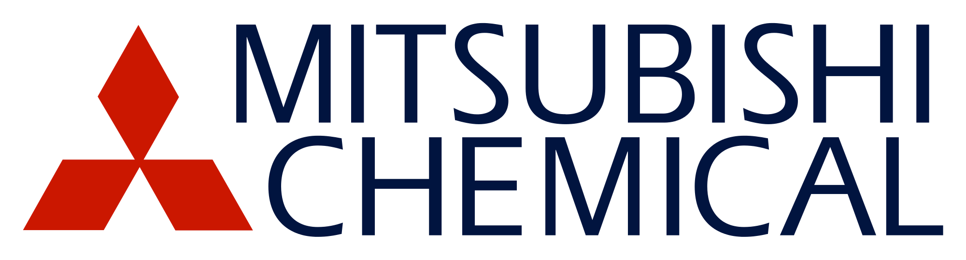
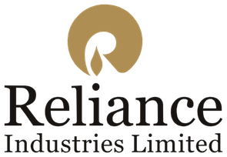



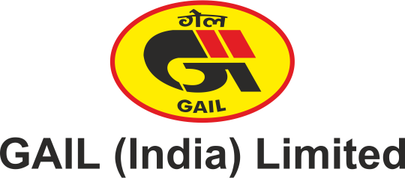

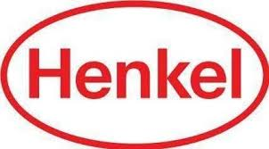





Representative list of clients

Slide 9

About Us & Disclaimer
TechSci Research is a global market research and consulting company with offices in the US, UK and India. TechSci Research provides market research reports in number of areas to organizations. The company uses innovative business models that focus on improving productivity, while ensuring creation of high-quality reports. The proprietary forecasting models use various analyses of both industry-specific and macroeconomic variables on a state-by-state basis to produce a unique ‘bottom-up’ model of a country, regional and global industry prospects. Combined with the detailed analysis of company activity and industry trends, the result is a uniquely rich evaluation of the opportunities available in the market.
Related Reports
Global HBPA Epoxy Resin Market By Physical Form (Solid and Liquid), By Application (Industrial Coating, E&E Coating and Others), Competition, Forecast & Opportunities, 2026
Global Composites Market By Type (Glass Fiber & Carbon Fiber), By Application (Civil Engineering, Aerospace & Défense, & Others), By Manufacturing Process (Lay Up, Injection Molding, etc.), By Region, Competition Forecast & Opportunities, 2012-2026
TechSci Research – North America
708 Third Avenue, Manhattan,
New York, United States
Tel: +1- 646- 360- 1656
Email: sales@techsciresearch.com www.techsciresearch.com
TechSci Research – Europe
54, Old brook, Bretton,
Peterborough,
United Kingdom
Email: sales@techsciresearch.com www.techsciresearch.com
TechSci Research – Asia-Pacific
B – 44, Sector – 57, Noida, National Capital Region, U.P. - India
Tel: +91-120-4523900
Email: sales@techsciresearch.com www.techsciresearch.com
Disclaimer
The contents of this report are based on information generally available to the public from sources believed to be reliable. No representation is made that it is timely, accurate or complete. TechSci Research has taken due care and caution in compilation of data as this has been obtained from various sources including which it considers reliable and first hand. However, TechSci Research does not guarantee the accuracy, adequacy or completeness of any information and it is not responsible for any errors or omissions or for the results obtained from the use of such information and especially states that it has no financial liability whatsoever to the subscribers / users of this report. The information herein, together with all estimates and forecasts, can change without notice. All the figures provided in this document are indicative of relative market size and are strictly for client’s internal consumption. Usage of the same for purpose other than internal will require prior approval of TechSci Research.

